Slide 1
Genome wide analysis results in gene lists
When analyzing high-throughput data, like Microarray experiment, the end result is often a list of genes.
Differentially expressed genes.
Cluster of highly correlated genes.
A natural next step is to identify the commonality between the genes in the list.
Similar annotations
Same Pathway
Components of a Protein Complex

Slide 2
Gene lists as a discovery tool
Depending on how the gene list was created, the genes can be used for discovering new things
For example if you have a cluster of highly correlated genes. One can look for novel Transcription Factor Binding sites by aligning the promoter regions of the genes in the cluster.
Many genes in the genome are still annotated as “unknown function”. Finding an “unknown” gene in a list consisting of genes only up-regulated by a given treatment allows the biologists to provide a putative function for the unknown gene.

Slide 3
Gene expression can be assayed across many different conditions
Experiment 1
Experiment 2
Experiment 3
Experiment 4
Experiment 5
Experiment 6
Experiment 7
Experiment 8
Experiment 9
Experiment 10
Gene 1
> 8.0
Gene 2
> 4.8
> 2.8
Gene 3
> 1.7
Gene 4
1:1
Gene 5
> 1.7
…
…
> 2.8
> 4.8
Gene 10,000
> 8.0
A separate microarray experiment is performed using mRNA isolated from each different “condition”, e.g.:
Developmental time course
Time course after exposure to some environmental stimulus (chemical, light/dark, etc.)
Different tissues
Normal vs. diseased tissue

Slide 4
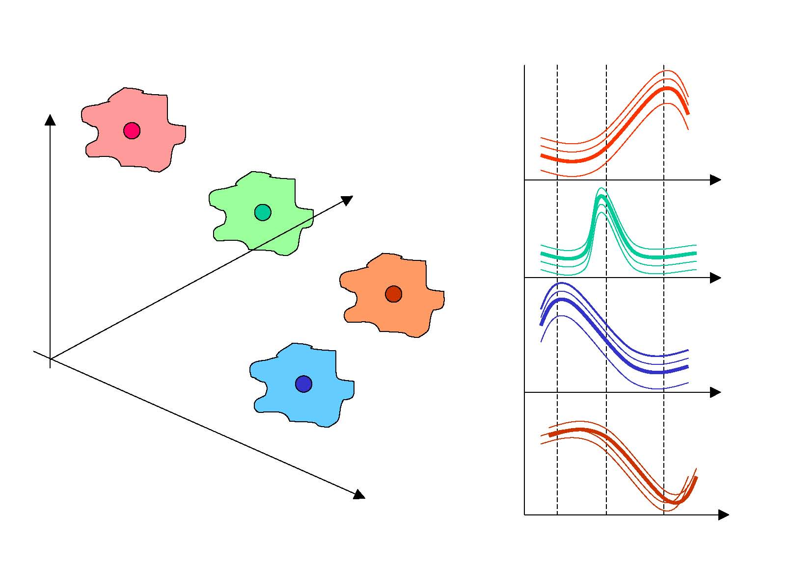
Clustering (genes)
Genes with similar expression profiles are likely to have common or related functions, and possibly to be co-regulated
T = 3
Similarly, conditions can be classified into different groups based on similarities in their expression profiles (all or subsets of genes).

Slide 5
Gene expression in multiple dimensions
y
Consider 3 experiments: x, y, and z
z
x
The expression vector for each gene can be represented as a point in 3-dimensional space, in which each axis represents the expression level in a different condition.
Genes with similar expression patterns fall nearby one another in this multi-dimensional space.

Slide 6
Coordinated Gene Expression
Which genes are co-expressed?
Hierarchal clustering
K-means clustering

Slide 7
Calculating Distance
Distance is the most natural method for numerical data
Lower values indicate more similarity
Distance metrics
Euclidean distance
Manhattan distance
Etc.
Does not generalize well to non-numerical data
What is the distance between “male” and “female”?

Slide 8
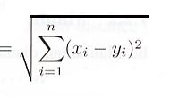
Euclidean distance
Implication for gene expression: the magnitude of expression values will determine distances
520
Gene expression
1090
experiments

Slide 9
Variance and Covariance
x₁ x₃
hybridization signal
x₂
y₁ y₃
y₂
experiment
variance measures dispersion from a mean value
Intuitively, covariance is the measure of how much two variables vary together
(x₁-x_{b})²+ (x₂-x_{b})²+(x₃-x_{b})²
(x₁-x_{b}) (y₁-y_{g})+……
n-1
n-1

Slide 10
covariance and correlation
Start with the concept of covariance
Cov_{xy}=
Implication for gene expression: the shape of gene expression responses will determine similarity
Σ (x_{i}-x)(y_{i}-y)
n
i=1
n-1
Normalize the measure by taking the variance of two measurements
VarX and VarY
√ (VarX)(VarY)
Pearson correlation has the nice property of varying between -1 and 1
-1
Gene expression
1
Σ (x_{i}-x)(y_{i}-y)
Pearson correlation coefficient
n
i=1
n-1
√ (VarX)(VarY)
experiments

Slide 11
Calculating Numerical Similarity
Traditionally over the range [0.0, 1.0]
0.0 = no similarity, 1.0 = identity
Converting distance to similarity
Distance and similarity are two sides of the same coin
To obtain similarity from distance, take the maximum pairwise distance and subtract from 1.0
Pearson correlation
Removes magnitude effects
In range [-1.0, 1.0]
-1.0 = anti-correlated, 0.0 = no correlation, 1.0 = perfectly correlated
In the example below, the dark and light blue lines have high correlation, even though the distance between the lines is significant
Expression level
Experiment

Slide 12
Clustering approaches
Agglomerative: hierarchical
Divisive: partitioning methods

Slide 13
Hierarchical Clustering
Find the pair(s) with the highest pairwise similarity
Join these as a group and calculate an “average” profile
(single, average, or complete linkage)
Iteratively join groups until all are linked
E
F
This example illustrates single-linkage clustering in Euclidean space on 6 points.
A
B
C
D
A B C D E F
The UPGMA method of phylogenetic reconstruction uses
average linking …

Slide 14
Clustering approaches
Agglomerative
Single linkage
(closest points are used)

Slide 15
Clustering approaches
Agglomerative
Single linkage
Centroid linkage
(center used for distance)

Slide 16
Clustering approaches
Agglomerative
Single linkage
Centroid linkage
Complete linkage
(furthest points are used)

Slide 17
Clustering approaches
Agglomerative
Single linkage
Centroid linkage
Complete linkage
Average linkage
(average of all distances used)

Slide 18
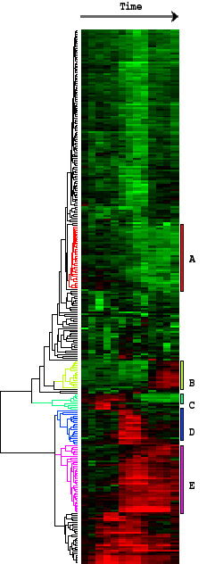
End Result
Conditions
Genes are grouped according to similarities in their expression levels across a variety of conditions.
Genes
(clustered by similarity in expression profiles)
Place genes with similar expression profiles into clusters.
Similarity is defined by Pearson correlation.

Slide 19
K-means: The Algorithm
Given a set of numeric points in d dimensional space, and integer k
Algorithm generates k (or fewer) clusters as follows:
Assign all points to a cluster at random.
Repeat until stable:
- Compute centroid for each cluster
- Reassign each point to nearest centroid

Slide 20
K-means: Example, k = 3
Step 1: Make random assignments and compute centroids (big dots)
Step 2: Assign points to nearest centroids
Step 3: Re-compute centroids (in this example, solution is now stable)

Slide 21
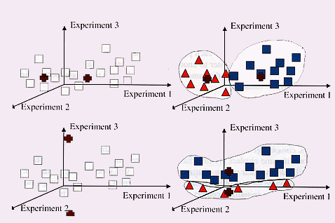
K-means weaknesses: can give you a different result each time with exactly the same data

Slide 22
K-means: Summary
Must choose parameter k in advance, or try many values.
Data must be numerical and must be compared via Euclidean distance (there is a variant called the k-medians algorithm to address these concerns)
The algorithm works best on data which contains spherical clusters; clusters with other geometry may not be found.
The algorithm is sensitive to outliers---points which do not belong in any cluster. These can distort the centroid positions and ruin the clustering.

Slide 23
Clustering has no one answer
Given a collection of objects, put objects into groups based on similarity.
It really depends on how you measure similarity/dissimilarity

Slide 24
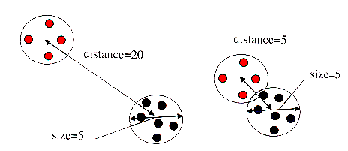
Judging the Quality of a Cluster
The idea is to classify distinct groups: other methods seek to directly optimize this trait in classification

Slide 25
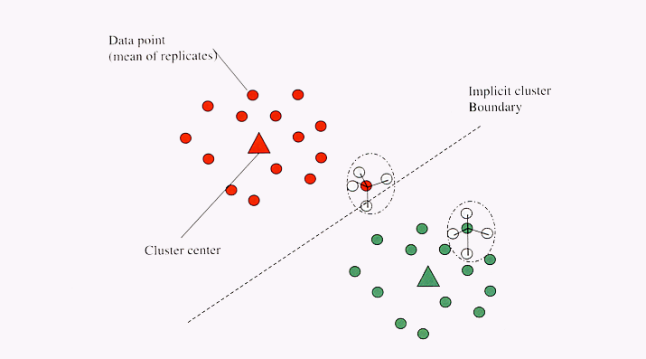
Measuring the Quality of Clusters
This guy has a low a_{i} and a big b_{i} so a high Silhouette value
Will lead to low or negative Silhouette values
Silhouette Width
Sil_{i} = (b_{i}-a_{i})/max(a_{i},b_{i})
a_{i}-average within cluster distance with respect to gene i
b_{i}-average between cluster distance with respect to gene i

Slide 26
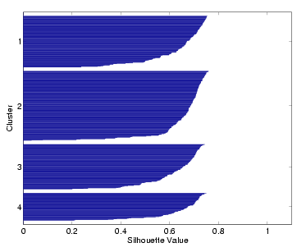
Silhouette Plot

Slide 27
Clustering the Breast Cancer dataset
What is the best way to cluster the 15k patients dataset?

